Slide 1
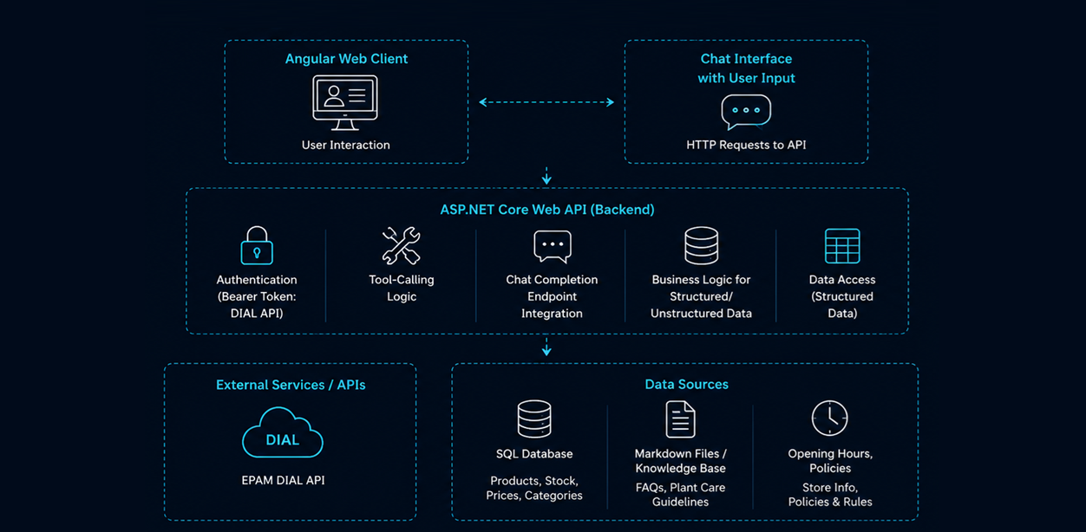
AI UPSKILL · MAY 2026
3-WEEK INITIATIVE
Garden Buddy Chatbot
TEAM
INTRODUCTION
OTHERS
László Kiss
.NET
A conversational AI chatbot developed to assist users in accessing information from structured and unstructured documentation. Built using state-of-the-art AI and web technologies, this solution provides instant, intelligent interaction with technical documentation, improving productivity and knowledge sharing.
IMPACT
Reduced response time for documentation-related queries by 80%. Improved access to accurate, consistent information across teams.
SOLUTION
[ Architecture Diagram ]
TECH STACK
LEARNINGS
.NET
Angular
SpecKit
Leveraged DIAL API effectively for AI-driven conversation logic. Optimized tool-calling mechanisms for structured and unstructured data.
Claude Code
Copilot
Dial API Key
GPT-4o
NEXT STEPS
Scale the chatbot to support voice-based interactions and real-time notifications. Integrate additional external knowledge sources for broader use cases.
BUSINESS CHALLENGES
The chatbot solution integrates the EPAM DIAL Core API to enable natural language question answering for technical documents. It utilizes GPT-4o and Claude Code for natural language understanding, combined with the COPILOT toolkit for rapid development.
The backend leverages .NET with ASP.NET Core for controlled tool execution, while Angular powers the user interface, offering real-time interaction and visually concise responses. The architecture includes structured data from SQL databases and indexed unstructured Markdown files for seamless retrieval.
Employees spend significant time searching for answers in technical documents.
Inconsistent or outdated responses from documentation.
Inefficient process of navigating through large knowledge bases.
Limited availability of subject-matter experts, delaying critical problem-solving.
ADDITIONAL NOTES
https://github.com/laszlokissepam/Laszlo_Kiss-AI_Upskill-May_2026
.NET AI UPSKILL INITIATIVE — MAY 2026
CONFIDENTIAL

